Slide 1

Behavioural
Factors
(SFIA v7)
Phil Lovell
SFIA Accredited Consultant
This is an interactive PPT.
View in Presentation mode to activate buttons. Press buttons to toggle text highlighting on and off.
Notes:
Created by: Phil Lovell - SFIA Accredited Consultant
Date 15 September 2020
Reviewed by: Penny Coulter - SFIA Accredited Consultant
Date 15 September 2020

Slide 2
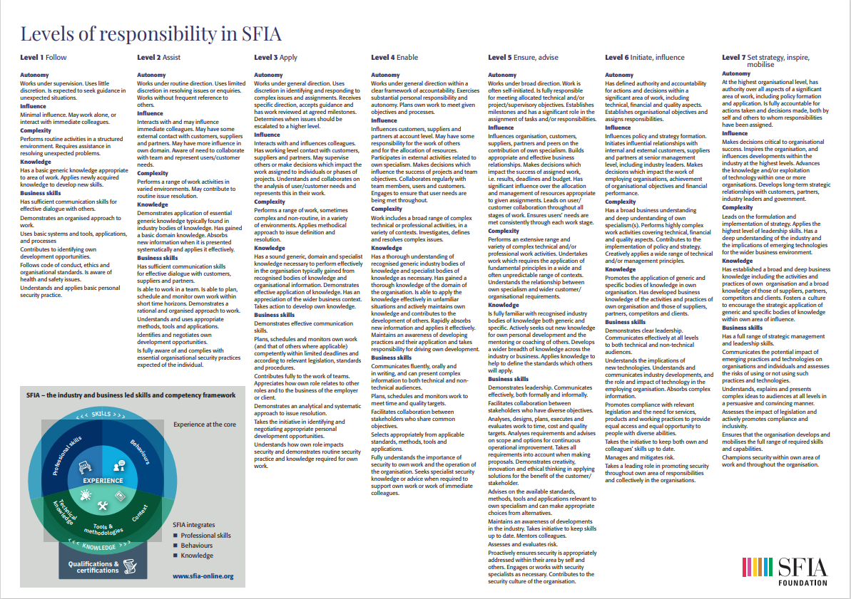
Context
Attribute
Behavioural Factor
Notes:
Use the buttons to toggle highlighting and hiding text

Slide 3
Collaboration
Creativity
Communication
Decision Making
Delegation
Execution Performance
Influence
Leadership
Learning and Professional Development
Planning
Problem Solving
Context
Attribute
Notes:
Use the buttons to toggle highlighting and hiding text

