Slide 1
SFIA - iCD Mapping Phase 2 & 3 Report
May 31, 2019
IT Human Resources Platform Department
IT Knowledge Center(IKC)
Information-technology Promotion Agency, Japan(IPA)

Slide 2
Contents
1. SFIA Skills vs iCD Tasks
2. Levels

Slide 3
SFIA Skills vs iCD Tasks
Method for mapping of SFIA Skills and iCD Tasks
SFIA
There are 5 categories, 16 subcategories and 102 skills as shown in Table 1.
iCD task dictionary
There are 7 task groups and 50 iCD task major categories as shown in Table 2.
Method for mapping
For each combination of a SFIA skill and an iCD task major category, whether there is a relevance or not is studied.
Table 1. SFIA
Table 2. iCD task dictionary
Category | Number of Subcategories | Number of Skills
 | 4 | 27
 | 1 | 12
 | 3 | 20
 | 3 | 20
 | 3 | 14
 | 2 | 9
Total 5 | 16 | 102
Task groups |  | Number of Task major categories
Planning & Execution (Lifecycle) |  | 3
 |  | 3
 |  | 15
 |  | 6
 |  | 6
 |  | 10
 |  | 7
Total 7 |  | 50
Strategy and architecture
Strategy(ST)
Change and transformation
Planning(PL)
Development and implementation
Development(DV)
Delivery and operation
Utilization(US)
Skills and quality
Evaluation & Improvement(EV)
Relationships and engagement
Management & Control(MC)
Promotion & Support(CM)

Slide 4
SFIA Skills vs iCD Tasks
Result of the mapping
The result of the mapping is shown in a form of a mapping table, which is a separate excel file. The image is shown in Table 3. Each cell in the table shows if there is a relevance or not.
A “tick” indicates there is a relevance.
Table 3. Mapping table
102 SFIA skills(Phase3)
20 SFIA skills(Phase2)
In the draft version of the file, there are two types of relevance:
Type1) Strong relevance (green cell)
Type2) Weak relevance (yellow cell)
Only Type1 is shown in the following figures.
（198 iCD task middle categories）
50 iCD task major categories

Slide 5
SFIA Skills vs iCD Tasks
Result of the mapping
The following 14 slides show images of mapping in each topic.
All the SFIA skills, all the iCD task major categories and all the relevance shown in the mapping table are shown in either one of the figures in Table 4.
Table 4. List of Figures
Figure | Topic | Note
1 | Business change management
2 | Life cycle process : from “Business analysis” to “Business modelling”
3 | Life cycle process : from “IT strategy planning” to “Architecture design”
4 | Life cycle process : from “Detailed design” to “Testing”(1/2)
5 | Life cycle process : from “Detailed design” to “Testing”(2/2)
6 | Life cycle process : Service transition
7 | Life cycle process : Service operation
8 | Life cycle process : Evaluations
9 | Life cycle process (UX based)
10 | Data management and data utilization
11 | Information security, quality & safety management
12 | Acquisition and Supply
13 | Organization development, HR & skill management
14 | Business continuity management

Slide 6
SFIA Skills vs iCD Tasks
Business change management
Figure 1
Business analysis
Business modelling
IT strategy planning
Requirements definition
Architecture design
Detailed design
Systems integration
Testing
Service transition
Service operation
Evaluations
Figure 2
Figure 3
Figure 4
Figure 6
Figure 7
Figure 8
Figure 5
Life cycle process (UX based)
Figure 9
Data management and data utilization
Figure 10
Information security, quality & safety management
Figure 11
Acquisition and Supply
Figure 12
Organization development and HR management
Figure 13
Business continuity management
Figure 14
List of Figures
6

Slide 7
SFIA Skills vs iCD Tasks
SFIA
Category
Change and transformation
Subcategory
Strategy and architecture
Business change management
Skill
Information strategy
POMG)
Portfolio management
CIPM)
Change implementation planning and management
CNSL)
Consultancy
PGMG)
Programme management
TECH)
Specialist advice
BPTS)
Business process testing
PRMG)
Project management
BENM)
Benefits management
PROF)
Portfolio, programme and project support
Dotted line shows there is a weak relevance.
Solid line shows there is a relevance.
Task group
iCD
Task major category
Development
DV15) Project management
This is a copy of a skill in Figure 4. The name is the same as SFIA skill PRMG, but DV15 is about management of systems development .
Figure 1. Business change management
7

Slide 8
SFIA Skills vs iCD Tasks
SFIA
Change and transformation
Business change management
BUAN) Business analysis
BSMO) Business modelling
Strategy and architecture
Business strategy and planning
DEMM) Demand management
INOV) Innovation
STPL) Enterprise and business architecture
RSCH) Research
BPRE) Business process improvement
ITMG) IT management
Technical strategy and planning
EMRG) Emerging technology monitoring
Business(+technology) analysis
Business analysis and modelling
iCD
Strategy
ST01) Business operations strategy formulation
ST0２) Understanding of business operations strategy and support for its formulation
Promotion & Support
CM02) Reuse
CM05) Investigation, analysis, and technical support of new businesses and technologies
CM04) Standards formulation, maintenance, and management
Figure 2. Life cycle process : from “Business analysis” to “Business modelling”
8

Slide 9
SFIA Skills vs iCD Tasks
SFIA
Change and transformation
Business change management
REQM)
Requirements definition and management
Strategy and architecture
Information strategy
Technical strategy and planning
GOVN)
Enterprise IT governance
ITSP)
Strategic planning
ISCO)
Information systems coordination
NTPL) Network planning
ARCH)
Solution architecture
METL) Methods and tools
IT strategic planning
Requirements definition
Architecture design
iCD
Strategy
Planning
ST03)
Formulation of IT products and services strategy
PL01)
IT strategy formulation and
execution promotion
PL02)
System planning
PL03) UI design
This is relevant to many other SFIA skills to some extent, but they are not shown.
Development
DV01)
System requirements definition/architecture design
Figure 3. Life cycle process : from “IT strategy planning” to “Architecture design”
9

Slide 10
SFIA Skills vs iCD Tasks
SFIA
Development and implementation
Systems development
DLMG) Systems development management
DESN) Systems design
PROG)
Programming/
software development
TEST) Testing
SWDN) Software design
DTAN) Data modelling and design
DBDS) Database design
NTDS) Network design
Installation and integration
PORT) Porting/
software configuration
SINT)
Systems integration and build
HWDE) Hardware design
Development project management
Detailed design
Systems integration
Testing
iCD
Development
DV02) Operation design
DV03) Transition design
DV05) Application system development
DV09) System test
DV04) Infrastructure system construction
DV10) Security test
DV14) Facility design and construction
DV15) Project Management
Figure 4. Life cycle process : from “Detailed design” to “Testing”(1/2)
10

Slide 11
SFIA Skills vs iCD Tasks
SFIA
Development and implementation
Systems development
INCA) Information content authoring
ADEV) Animation development
This is a copy of skills in Figure 4.
DESN) Systems design
PROG)
Programming/
software development
SWDN) Software design
DTAN) Data modelling and design
DBDS) Database design
NTDS) Network design
RESD) Real-time/embedded systems development
Website / Software product / Embedded systems development (design, integration, testing)
iCD
Development
DV08) Website development
DV06) Software product development
DV07) Embedded software development
Figure 5. Life cycle process : from “Detailed design” to “Testing”(2/2)
11

Slide 12
SFIA Skills vs iCD Tasks
SFIA
Development and implementation
Installation and integration
HSIN)
Systems installation/decommissioning
Delivery and operation
Service transition
SEAC)
Service acceptance
CHM)G Change management
ASMG) Asset management
CFMG) Configuration management
RELM)
Release and deployment
Service transition
Asset management
iCD
Development
Evaluation & Improvement
DV11) Transition and installation (System release)
EV06) Asset management and evaluation
DV13) Hardware and software product installation
Utilization
US06) Service management
Figure 6. Life cycle process : Service transition

Slide 13
SFIA Skills vs iCD Tasks
SFIA
Delivery and operation
Relationships and engagement
Service design
Service operation
Stakeholder management
SLMO) Service level management
AVMT) Availability management
REFN) Radio frequency engineering
Service transition
ASUP) Application support
DBAD) Database administration
Service operation
CPMG) Capacity management
NTAS) Network support
CSMG) Customer service support
USUP) Incident management
SYSP) System software
PBMG) Problem management
STMG) Storage management
SCAD) Security administration
ITOP) IT infrastructure
PENT) Penetration testing
DCMA) Facilities management
Overall IT service management
Security management
System components management
Customer support
iCD
Development
DV12)
Software Maintenance
Utilization
US02)
IT operation control
US04)
Website operations management
US01)
Service desk
US03)
System operations management
US05)
Facility operations management
Figure 7. Life cycle process : Service operation

Slide 14
SFIA Skills vs iCD Tasks
SFIA
Skills and quality
Quality and conformance
SFAS) Safety assessment
iCD
Evaluation & Improvement
EV01) System evaluation and improvement
EV02) IT strategy evaluation and improvement
EV03) IT products and services strategy evaluation and improvement
EV04) Business operations strategy evaluation support and improvement support
EV05) Business operations strategy evaluation and improvement
Figure 8. Life cycle process : Evaluations
14

Slide 15
SFIA Skills vs iCD Tasks
SFIA
Development and implementation
URCH) User research
UNAN) User experience analysis
HCEV) User experience design
USEV) User experience evaluation
Life cycle process (UX based) : IT strategy planning,
Requirements definition, Architecture design, Detailed design, Systems integration, Testing, Service transition, Service operation
iCD
Promotion & Support
CM07) New product/service development by new value creation
Figure 9. Life cycle process (UX based)
15

Slide 16
SFIA Skills vs iCD Tasks
SFIA
Strategy and architecture
Business strategy and planning
KNOW) Knowledge management
Information strategy
IRMG)
Information governance
INAN)
Analytics
VISL)
Data visualisation
ICPM)
Information content publishing
Technical strategy and planning
DATM) Data management
Data management
Data utilization
iCD
Management &Control
Promotion & Support
MC04)
Data management
CM06) Data utilization
Figure 10. Data management and data utilization
16

Slide 17
SFIA Skills vs iCD Tasks
SFIA
Strategy and architecture
Skills and quality
Development and implementation
Information strategy
Quality and conformance
Systems development
SCTY)
Information security
DGFS) Digital forensics
QUMG) Quality management
SFEN) Safety engineering
QUAS) Quality assurance
INAS)
Information assurance
MEAS) Measurement
CORE) Conformance review
Information security management
Quality management
Safety management
iCD
Management &Control
Development
MC03) Information security management
MC05) Quality Management
DV07) Embedded software development
This is a copy of skills in Figure 5.
Figure 11. Information security, quality & safety management
17

Slide 18
SFIA Skills vs iCD Tasks
SFIA
Relationships and engagement
Stakeholder management
Sales and marketing
RLMT)
Relationship management
PROD)
Product management
ITCM)
Contract management
SORC)
Sourcing
SUPP)
Supplier management
MKTG)
Marketing
SALE)
Selling
SSUP)
Sales support
Contract management
Acquisition
Supply
iCD
Management & Control
Promotion & Support
MC06)
Contract management
CM03) Procurement and outsourcing
CM01) Marketing and sales
Figure 12. Acquisition and Supply

Slide 19
SFIA Skills vs iCD Tasks
SFIA
Change and transformation
Skills and quality
Business change management
Skill management
OCDV)
Organisational capability development
ETMG)
Learning and development management
LEDA)
Competency assessment
TMCR)
Learning design and development
ETDL)
Learning delivery
ORDI)
Organisation design and implementation
TEAC)
Teaching and subject formation
People management
RESC)
Resourcing
PEMT)
Performance management
PDSV)
Professional development
Organization development
HR management
iCD
Management & Control
MC01) Line management
MC08) Human resource management
Figure 13. Organization development and HR management
19

Slide 20
SFIA Skills vs iCD Tasks
SFIA
Strategy and architecture
Business strategy and planning
FMIT) Financial management
BURM) Business risk management
SUST) Sustainability
Technical strategy and planning
COPL) Continuity management
Business continuity management
iCD
Management &Control
MC02) Business continuity management
MC10) System audit
MC07) Compliance
MC09) Internal control status monitoring
Figure 14. Business continuity management
20

Slide 21
SFIA Skills vs iCD Tasks
Result of the mapping
Figure 15 shows a rough mapping derived from the previous figures.
SFIA
iCD
Strategy and architecture
Strategy(ST)
Planning & Execution (Lifecycle)
Change and transformation
Planning(PL)
Development(DV)
Development and implementation
Utilization(US)
Delivery and operation
Evaluation & Improvement(EV)
Skills and quality
Management & Control(MC)
Relationships and engagement
Promotion & Support(CM)
Figure 15. Overall mapping

Slide 22
2. Levels
Method for mapping of SFIA Skill Levels and iCD Task Levels
SFIA
The levels are described for each skill. This is done through a mix of the Generic Responsibilities, the Skills Description and the Level Description for the skill. Refer to Figure 16.
iCD task dictionary
The levels are not described for each task and only an example of very brief description, or task evaluation diagnostic criteria common to all the tasks are given. Refer to Figure 17.
Method for mapping
Therefore, it is reasonable to compare the key points of “Generic Responsibilities” of SFIA and the “diagnostic criteria of iCD task dictionary”.

Slide 23
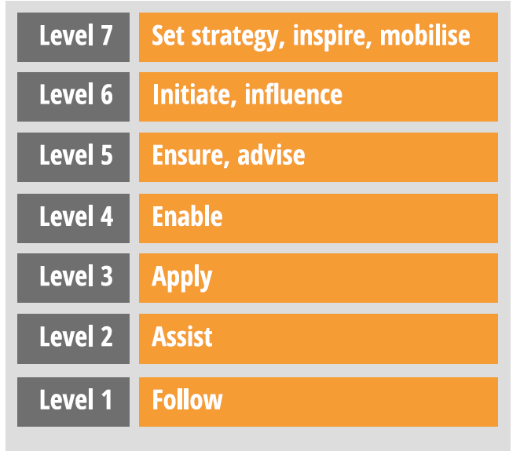
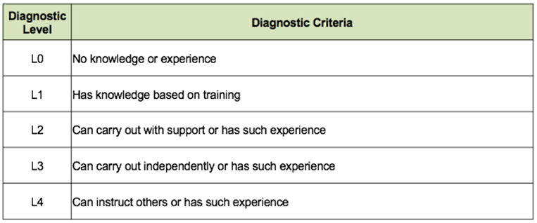
2. Levels
iCD’s Examples of Task Assessment Diagnostic Level and Diagnostic Criteria
SFIA’s seven levels of responsibility
The levels of responsibility are characterised by a number of generic attributes:
Autonomy
Influence
Complexity
Knowledge
Business Skills
In order to do make the mapping feasible, the diagnostic criteria are broken into four groups :
Autonomy
Influence
Knowledge
Experience
Figure 16. Levels in SFIA
Figure 17. Levels iCD

Slide 24
2. Levels
Result of the mapping
Figure 18 shows the detailed result of the mapping.
ex. iCD L1 is characterized by “Has knowledge based on training” and this is mapped to SFIA L1 “Has a basic generic knowledge”.
Figure 19 shows the summarized result of the mapping.

Slide 25
2. Levels
 | L1 | L2 | L3 | L4 | L5 | L6 | L7
 | Follow | Assist | Apply | Enable | Ensure, advise | Initiate, influence | Set strategy, inspire, mobilise
Autonomy | Works under supervision. | Works under routine direction. | Works under general direction. | Works under general direction within a clear framework of accountability. | Works under broad direction. | Has defined authority and accountability… | At the highest organisational level, has authority …
Influence | Minimal influence. | Interacts with and may influence immediate colleagues. | Interacts with and influences colleagues. | Influences customers, suppliers and partners at account level. | Influences organisation, customers, suppliers, partners and peers | Influences policy and strategy formation. | Makes decisions critical to organisational success.
Complexity | Performs routine activities… | Performs a range of work activities in varied environments. | Performs a range of work, sometimes complex and non-routine… | Work includes a broad range of complex technical or professional activities… | Performs an extensive range and variety of… | Has a broad business understanding and deep understanding… | Leads on the formulation and implementation of strategy.
Knowledge | Has a basic generic knowledge. | Demonstrates application of essential generic knowledge… | Has a sound generic, domain and specialist knowledge… | Has a thorough understanding of recognised generic industry bodies of knowledge | Is fully familiar with recognised industry bodies of knowledge both generic and specific. | Promotes the application of generic and specific bodies of knowledge in own organisation. | Has established a broad and deep business knowledge
Business skills | Has sufficient communication skills… | Has sufficient communication skills … | Demonstrates effective communication skills. | Communicates fluently, orally and in writing | Demonstrates leadership. | Demonstrates clear leadership…. | Has a full range of strategic management and leadership skills.
SFIA
“Levels of responsibility”
 | L0 | L1 | L2 | L3 | L4
Autonomy |  |  | Can carry out with support | Can carry out independently
Influence |  |  |  |  | Can instruct others
Knowledge | Nothing | Has knowledge based on training | - | - | -
Experience | Nothing | - | Has such experience | Has such experience | Has such experience
iCD
“Task diagnostic criteria”
Figure 18. Mapping of Levels in SFIA and iCD (detail)
25

Slide 26
2. Levels
L4 | Can instruct others or has such experience
L3 | Can carry out independently or has such experience
L2 | Can carry out with support or has such experience
L1 | Has knowledge based on training
L0 | No knowledge or experience
SFIA’s seven levels of responsibility
iCD - Examples of Task Assessment Diagnostic Level and Diagnostic Criteria
Figure 19. Mapping of Levels in SFIA and iCD (summary)

Slide 27
END

